Slide 1
Sprint Twitter Data Analysis
By: Trinadha Rajeswari Muppala, Velivela Hari Naga Raju,
Matturi Vinay and Walsh Jr David Paige

Slide 2
Overview
Motivation
Architecture –Build Model
Extracting Data and Features
Label data
ML Models
Architecture – Testing
Feature Work

Slide 3
Motivation
Text data processing.Analyze Sprint customer feed back from tweets. Perform sentiment analysis to label the data.
Build ML models and predict feed back.

Slide 4
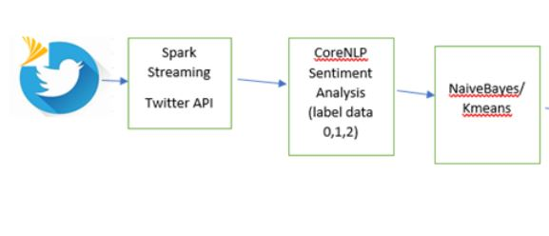
Architecture Building Model

Slide 5
Extracting Data and feature
Node.js - used to gather the intial data set of tweets and store to a MongoDB
Spark Data Frames - Load json extract the tweet text, id , location
Spark Streaming
TwitterUtils
CluLab implementation of StanforeCoreNLP

Slide 6
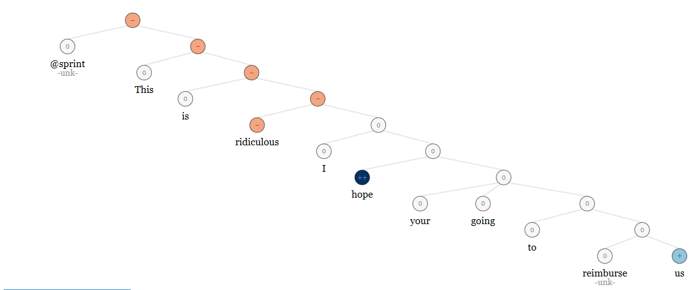
Label Data – CoreNLP Sentiment Analysis
Sentiment Analysis is the process of computationally identifying and categorizing opinions expressed in a piece of text, especially in order to determine whether the writer's attitude towards a particular topic, product, etc., is positive, negative, or neutral. Label tweet as negative – 0 , neutral – 1 , positive -2
@sprint This is ridiculous I hope your going to reimburse us

Slide 7
Twitter Streaming
val filters = args.take(args.length)
val stream = TwitterUtils.createStream(ssc, None, filters)
TwitterUtils accepts using a properties file to set the credentials to access the Twitter API, which if used requires the 2nd input to be None.
Filters are passed as arguments to the program and are used to filter the tweets by the text content:
In our case the arguments were set to @sprint @sprintcare

Slide 8
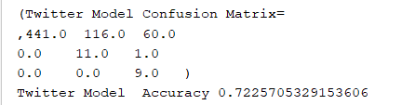
Naïve Bayes
Map Sequence of terms to their term frequencies using the hashing trick
Split data 70%, 30% testing and training

Slide 9
K-means clustering
perform the classification algorithms on the output of the sentiment analysis.
number of clusters = 3
( tweets are of three types, they are positive, negative, neutral).
euclidean distance

Slide 10
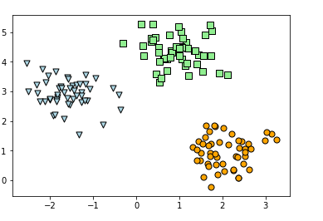
K-Means:

Slide 11
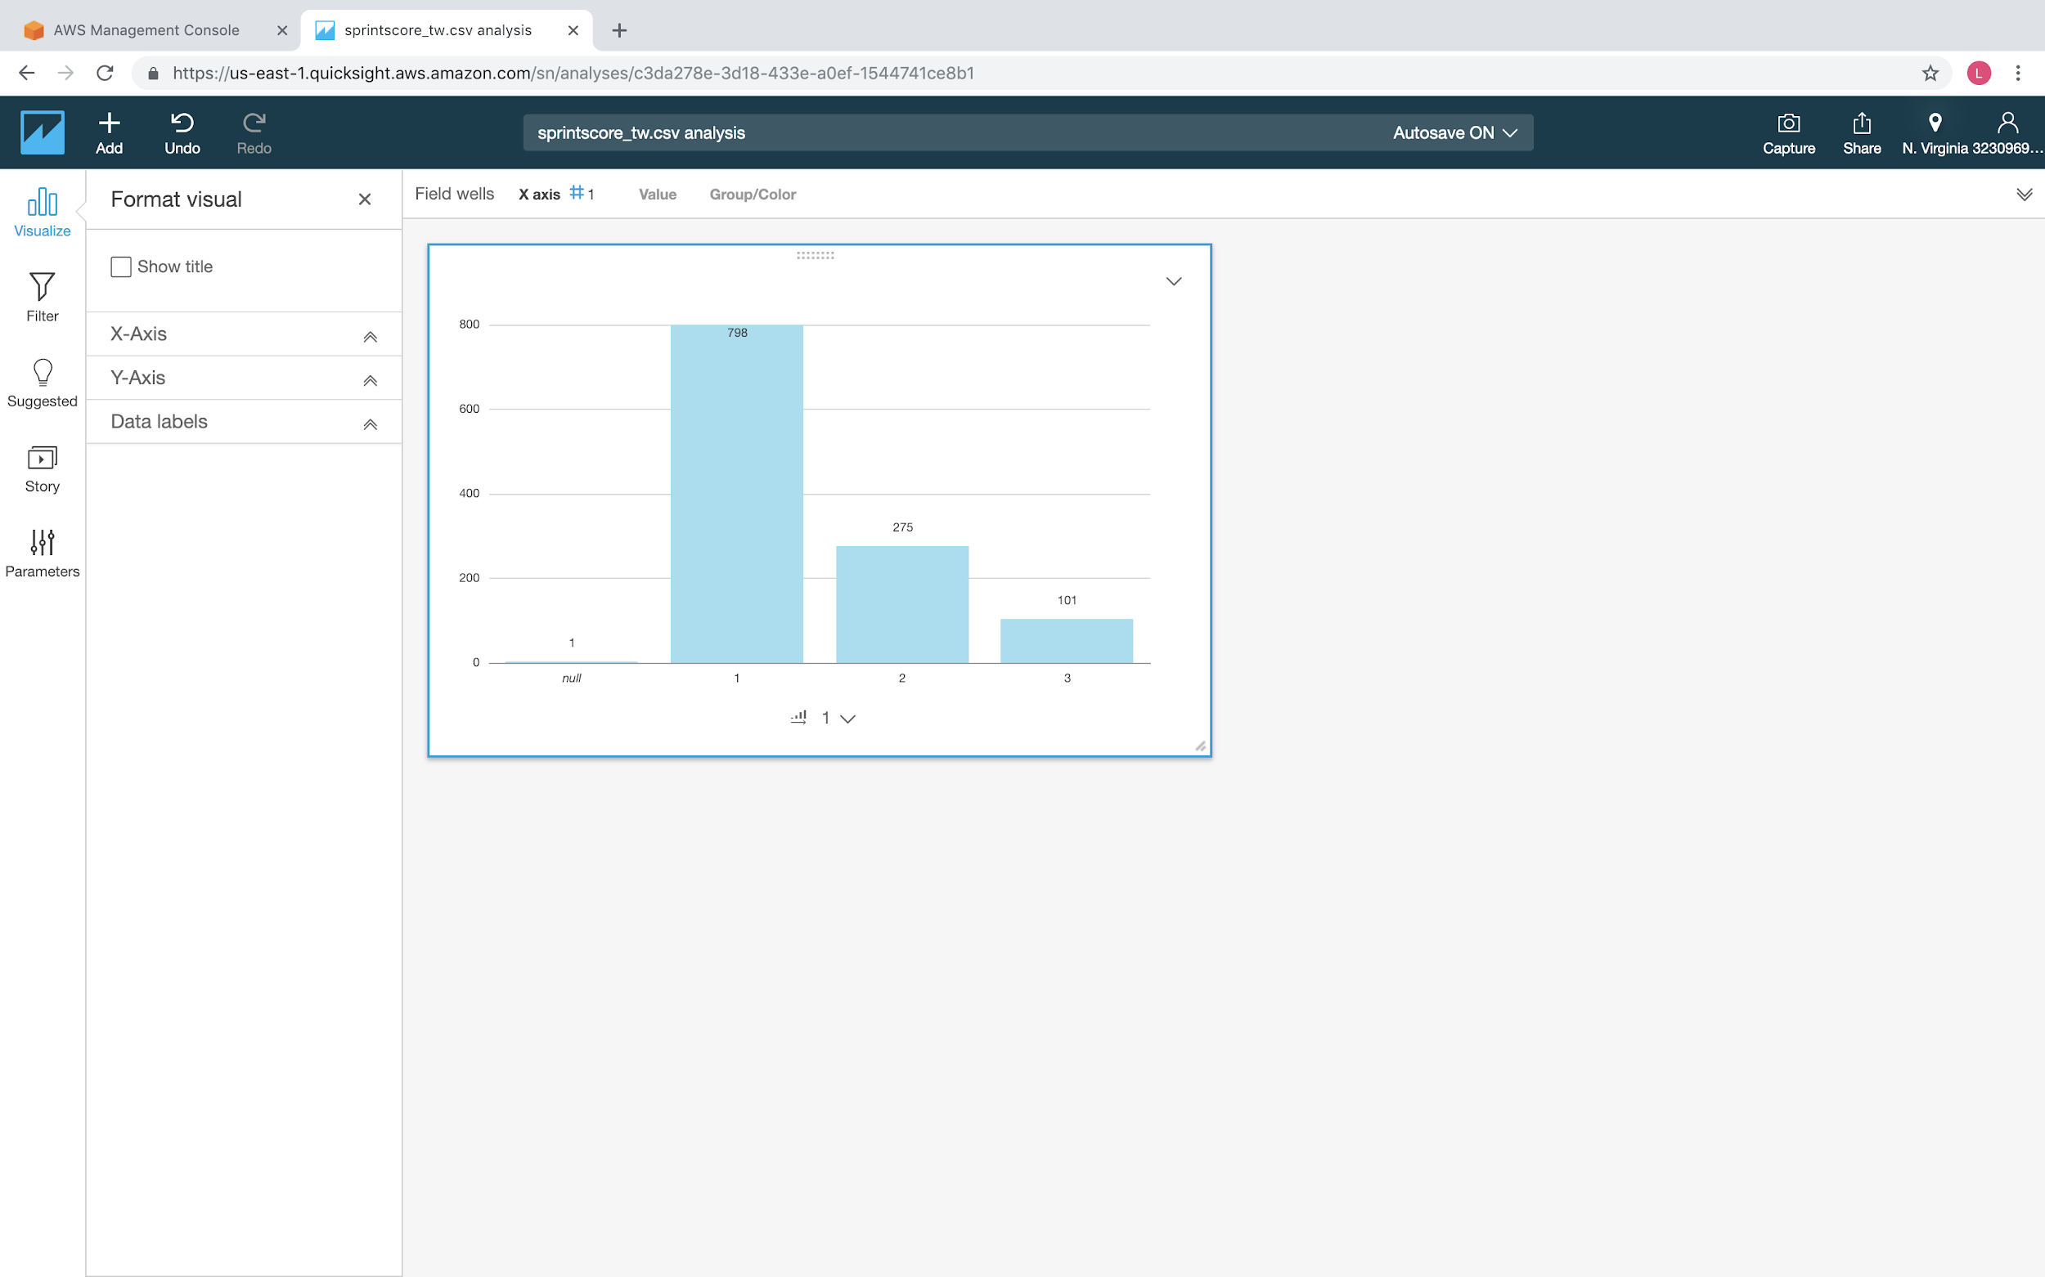
tweet analysis

Slide 12
Sentiment Analysis of Live Data
val data = stream.map{status =>
val sentiment = CoreNLPSentimentAnalyzer.sentiment(status.getText)
val avgSent = sentiment.reduce(_+_)/sentiment.length
//val tweetInWords: Seq[String] = getBarebonesTweetText(status.getText, stopList)
//val bayesScore = naiveBayesModel.predict(transformFeatures(tweetInWords))
val bayesScore = 2
(status.getId, avgSent, bayesScore, status.getGeoLocation, status.getLang, status.getUser.getLocation, status.getText)
}
The tweet text is processed by the SentimentAnalyzer process, which returns an array of scores. One for each sentence in the tweet. These scores are averaged using reduction.

Slide 13
The problem with NB on Live Data
Plugging in the code for the NB analysis resulted in multiple processes being spawned.
Each process attempted to access twitter resulting in throttling of access
Created a memory leak causing the system to run out of memory available and thus crashing the application

Slide 14
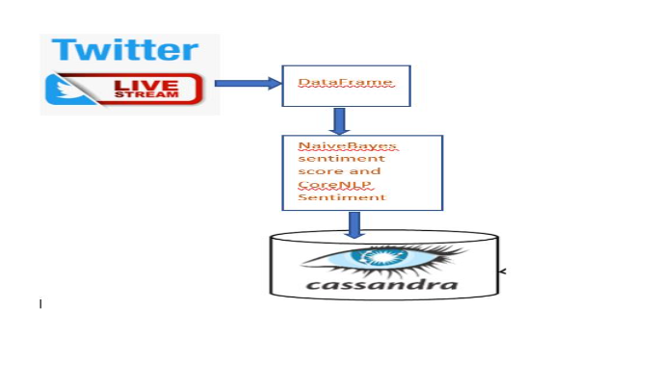
Architecture for Testing

Slide 15
Setting up Cassandra
CREATE KEYSPACE "tweets"
WITH replication = {'class': 'SimpleStrategy', 'replication_factor' : 1};
CREATE TABLE tweet(
t_id bigint,
t_avgsent int,
t_bayes int,
t_geo text,
t_lang text,
t_location text,
t_text text.
PRIMARY KEY (t_id));
t_id | t_avgsent | t_bayes | t_geo | t_lang | t_location | t_text
------+-----------+---------+-------+--------+------------+--------

Slide 16
Saving to Cassandra
val conf = new SparkConf()
.set("cassandra.connection.host","127.0.0.1:9042")
===========================
data.foreachRDD{rdd=>
if (rdd.count() > 0) {
rdd.saveToCassandra("tweets","tweet")
}
}
Set a connection to the Cassandra DB in the configuration.
Save the data to the tweets keyspace in the tweet table
Simple implementation by using the RDDs contained within the Tweet stream

Slide 17
t_id | t_avgsent | t_bayes | t_geo | t_lang | t_location | t_text
---------------------+-----------+---------+-------+--------+---------------------------------+--
1070426178995945472 | 3 | 2 | null | en | Los Angeles | @sprintcare @MichelCombes Thanks!
1070672526727094279 | 3 | 2 | null | en | Bronx, NY | @sprint the best
1070678099124056065 | 3 | 2 | null | en | Albuquerque, NM | @sprint I hope everyone has a safe and wonderful holiday! Γ¥ñ∩╕Å #MerryandBrightSweepstakes
1071081992593260545 | 3 | 2 | null | en | Campbell, California | RT @RANGlobal: A great first panel discussion moderated by @MobileExperts1, with @sprint @Bell @ATT talking on the expectations of 5G fromΓÇª
Data
SELECT count(*) from tweet;
count
-------
2237
(1 rows)

Slide 18
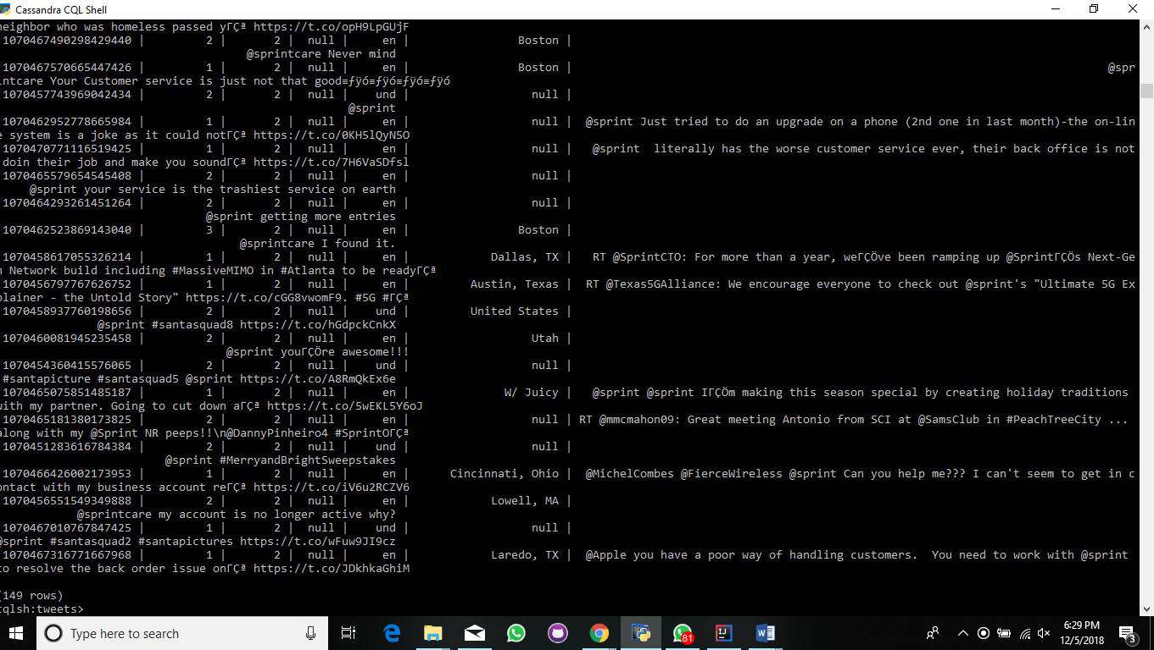
Data in Cassandra.
Select * from tweets where t_location=”%Mo”;

Slide 19
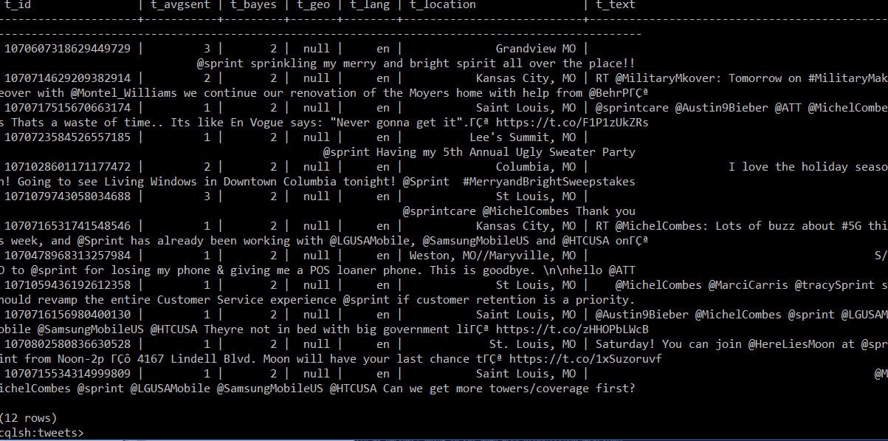
Queries On Cassandra Data

Slide 20
Feature Work
CoreNLP sentiment analysis results are not good. Use TFIDF identify important words and use those words to label
Extend classification from positive, negative, neutral to specific area
Build Decision Tree Model .

Slide 21
References and Links
1)https://github.com/apache/bahir/blob/master/streaming-twitter/examples/src/main/scala/org/apache/spark/examples/streaming/twitter/TwitterHashTagJoinSentiments.scala
2)https://www.tutorialspoint.com/cassandra/cassandra_create_keyspace.htm
3)https://nlp.stanford.edu/sentiment/
4)https://scikit-learn.org/stable/modules/generated/sklearn.cluster.KMeans.html

